Slide 1


Scheduling and Organizing the Intervention/Enrichment Period for Tiered Instruction in Response to Intervention
Michael D. Rettig
rettigmd@jmu.edu
Professor Emeritus
James Madison University
www.schoolschedulingassociates.com
Notes:
Designing Quality Elementary School Master Schedules
12/2/09
Michael D. Rettig, rettigmd@jmu.edu
1

Slide 2
Agenda
What is Response to Intervention (RTI)?
What is an Intervention/Enrichment Period?
Why do schools need/implement the I/E period?
Scheduling Time for Intervention and Enrichment in Elementary, Middle, and High Schools.
Organizing the Intervention/ Enrichment Period.
Notes:
Designing Quality Elementary School Master Schedules
12/2/09
Michael D. Rettig, rettigmd@jmu.edu
2

Slide 3
I/E Scheduling Issues
Where should the time come from to create the I/E period?
How many periods should be scheduled?
Where in the schedule should the I/E period be placed?
Notes:
Designing Quality Elementary School Master Schedules
12/2/09
Michael D. Rettig, rettigmd@jmu.edu
3

Slide 4

Time Allocation Chart
Notes:
Designing Quality Elementary School Master Schedules
12/2/09
Michael D. Rettig, rettigmd@jmu.edu
4

Slide 5
However…remember the prime rule of school scheduling:
To put something in, you must take something out!

Slide 6
Caveat emptor!
Scheduling the Intervention/Enrichment period is relatively easy.
Changing the culture of a school to one in which teachers and administrators collaborate on data analysis, progress monitoring, and the organizational tasks necessary to make the I/E period truly responsive to students’ learning needs is very difficult!

Slide 7
Intervention/Enrichment Processes

Slide 8
RTI Student Tiers
Tier 1: Learn basic curriculum through typical instruction w/differentiation.
Tier 2: Need periodic intervention; should receive enrichment when not receiving intervention.
Tier 3: Need long-term and intensive intervention; enrichment???

Slide 9
I/E Organization
Elementary School: Within Class, Within Grade, Multiple-Grade, School-wide
Middle School: Within Team, Within Grade, School-wide
High School: Partial School-wide (multiple periods) and School-wide

Slide 10

Now available at www.eyeoneducation.com.
Notes:
Designing Quality Elementary School Master Schedules
12/2/09
Michael D. Rettig, rettigmd@jmu.edu
10

Slide 11

Master Block Schedule (Full-Day Kindergarten)
50 min.
Blocks
8:00-
8:50
8:50-
9:40
9:40-
10:30
10:30-
11:20
11:20-
12:10
12:10-
1:00
1:00-
1:50
1:50-
2:40
Kind.
Core
Core
I/E
L/R
Core
Encore/
Plan
Core
Core
Gr. 1
Core
Core
Core
R/L
Core
Core
Encore/ Plan
I/E
Gr. 2
Core
Core
Core
Core
Core
R/L
I/E
Encore/Plan
Gr. 3
Core
Core
Core
I/E
Encore/ Plan
L/R
Core
Core
Gr. 4
Core
I/E
Encore/
Plan
Core
L/R
Core
Core
Core
Gr. 5
I/E
Encore/
Plan
Core
Core
R/L
Core
Core
Core
Encore
Plan
Gr. 5
Gr. 4
L/R
Gr. 3
K
Gr. 1
Gr. 2
I/E
Gr. 5
Gr. 4
K
Gr. 3
L/R
Plan
Gr. 2
Gr. 1

Slide 12
Elementary School Scheduling of the Intervention/Enrichment Period
Notes:
Designing Quality Elementary School Master Schedules
12/2/09
Michael D. Rettig, rettigmd@jmu.edu
12

Slide 13
Two I/E Periods per Grade Level
Notes:
Designing Quality Elementary School Master Schedules
12/2/09
Michael D. Rettig, rettigmd@jmu.edu
13

Slide 14
Two Basic Approaches to I/E Organization in Elementary Schools
The Centers Approach
Individual classroom teachers organize enrichment centers for tier 1 students.
Classroom teachers pull small groups from centers to provide Tier 2 (moderate, short-term) interventions.
Clinical specialists pull-out (or push-in) and provide Tier 3 (intense, longer-term) interventions.
The Re-grouping Approach
Classes are re-grouped across a team or grade level to form tiered groups.
Tier 1 students are provide enrichment by one more classroom teachers or other personnel (Gifted, encore, etc.).
Tier 2 students are provide interventions by other classroom teachers.
Tier 3 students are provided interventions by clinical specialists.

Slide 15
Table 4.1 Sample Structure of Intervention/Enrichment Period for One Grade Level
Groups | Activity | Staff
25% of students | Writing lab | One (of three) classroom teachers
25% of students | Science and social studies enrichment activities | Library/media specialist
15% of students | Math interventions | Second classroom teacher or computer lab
35% of students | Reading interventions | Third classroom teacher, LD teacher, 2 reading specialists
Notes:
Designing Quality Elementary School Master Schedules
12/2/09
Michael D. Rettig, rettigmd@jmu.edu
15

Slide 16
Table 4.2 Sample Structure of Intervention/Enrichment Period for One Grade Level with Four Base Teachers and 92 Students
Number of students | Activity | Staff
20 students | Social studies enrichment | TAG teacher
15 students | Science enrichment | Library/media specialist or classroom teacher
18 students | Writing lab | Title I or reading specialist
12 students | Special services | LD teacher, ESL teacher, speech/language teacher
10 students | Math interventions | Math specialist, classroom teacher, and/or computer lab
17 students | Reading interventions | Title I, reading specialist, SPED teacher, one or more classroom teachers
Notes:
Designing Quality Elementary School Master Schedules
12/2/09
Michael D. Rettig, rettigmd@jmu.edu
16

Slide 17



MS and HS I/E Scheduling Ideas
Available at www.eyeoneducation.com

Slide 18
The Four-Block Schedule with an Intervention/Enrichment Period
Day 1
Day 2
9th Period
PE/Exp./Elec./Interv./Enr.
Block I
Language Arts and Reading
Block II
Mathematics
Block III
Social Studies
Science
Block IV
PE/Exp./Elec.
PE/Exp./Elec.

Slide 19
I/E Period Placement Options
1st Period School-wide
After Block I School-wide
Three Grade-level Periods Around Block I
Two (6 & 7-8) Periods Around Block I
Three Grade-level Periods Around Early Lunch
Three Grade-level Periods Around Late Lunch
Other Options

Slide 20


Slide 21
I/E Period Placed in 1st Period Slot
Pros
Easy to Schedule
No split blocks
Doesn’t affect Encore schedule
Multi-grade level possibilities (i.e.Band)
Cons
What about HR, attendance, etc?
Personnel who work with all three grade levels (SPED, ESL, Elective, Reading, etc.) must be spread among all grades.
Loses gravitas..used as buffer for late arrivals; abused by students/parents for orthodontics appts. etc.

Slide 23
I/E Period Placed after Block I
Pros
Easy to Schedule
No split blocks
Doesn’t affect Encore schedule
First Block can be HR
Multi-grade level possibilities (i.e.Band)
Cons
Personnel who work with all three grade levels (SPED, ESL, Elective, Reading, etc.) must be spread among all grades.

Slide 25
Three Grade Level I/E Periods Built Around Block I
Pros
Easy to Schedule
Personnel who work with all three grade levels (SPED, ESL, Elective, Reading, etc.) may work with each grade level separately in 3 different periods.
Cons
What about HR, attendance, etc. for grade 6?
Split block for one grade (Grade 7)
Extra class change for one grade (Grade 7)
Lack of gravitas for grade 6 period

Slide 27
Two (6th & 7-8) I/E Periods Built Around Block I
Pros
Easy to Schedule
Doesn’t affect Encore schedule
Personnel who work with 6th grade students and either 7th or 8th grade students (SPED, ESL, Elective, Reading, etc.) may work with two levels in two different periods.
Cons
What about HR, attendance, etc. for grade 6?
Personnel who work with 7th and 8th grade levels (SPED, ESL, Elective, Reading, etc.) must be spread among students in these two grades.

Slide 29
Three Grade Level I/E Periods Built Around Early Lunch
Pros
Personnel who work with all three grade levels (SPED, ESL, Elective, Reading, etc.) may work with each grade level separately in 3 different periods.
Room for advisory?
May help lunch schedule?
Elective/resource teachers may be available for duty during lunch.
Cons
Prevents grade level Encore classes from being scheduled in two blocks forcing one grade level into Block I planning
Period (@36 m) and blocks (@ 76m) are shortened.
Room for advisory?
May make lunch schedule more difficult?

Slide 31
Three Grade Level I/E Periods Built Around Late Lunch
Pros
Personnel who work with all three grade levels (SPED, ESL, Elective, Reading, etc.) may work with each grade level separately in 3 different periods.
Room for advisory?
May help lunch schedule?
Elective/resource teachers may be available for duty during lunch.
Cons
Prevents grade level Encore classes from being scheduled in two blocks forcing one grade level into Block I planning
Period (@36 m) and blocks (@ 76m) are shortened.
Room for advisory?
May make lunch schedule more difficult?

Slide 32
Other I/E Period Placement Options
End of the day.
Before last block (after the lunch blocks).
2 or 3 periods built around last block.
After second block before the lunch periods.
Others?

Slide 33
Kate Collins Plan For Intervention/Enrichment Period
Notes:
Designing Quality Elementary School Master Schedules
12/2/09
Michael D. Rettig, rettigmd@jmu.edu
33

Slide 34
Two Basic Approaches to I/E Organization in Middle Schools
Team/Grade Level
Data Grouping
Based upon formative assessment data students are assigned to intervention or enrichment activities.
Some teachers provide enrichment activities to Tier 1 and 2 students.
Other teachers pull Tier 2 students on an occasional basis from enrichment activities.
Clinical specialists pull-out (or push-in) and provide Tier 3 (intense, longer-term) interventions.
Teacher Selection
Teachers select students who need intervention activities through a web-based management system. Different subjects are given priority during different selection windows.
Non-selected students are assigned (or possibly may chose) enrichment activities.
See for example: www.aaaselect.com

Slide 35
7 A/B with Intervention/Enrichment Period
 | M | T | W | R | F
Block 1 (90) | 1 | 2 | 1 | 2 | 1
Block 2 (90) | 3 | 4 | 3 | 4 | 3
Block 3 (82) | 5 and Lunch | 5 and Lunch | 5 and Lunch | 5 and Lunch | 5 and Lunch
Block 4 (90) | 7 | 6 | 7 | 6 | 7
(30)
School-wide Intervention/Enrichment Period

Slide 36
The 8 A/B Schedule with and Intervention/Enrichment Block
Day 1
Day 2
Block I
1
2
Block II
3
4
Block III
5
6
Intervention/
Enrichment
Block IV
7

Slide 37
Westfield HS, Fairfax County, VA
2009-10 Regular Bell Schedule (Monday, Wednesday, Thursday)
2009-10 Bulldog Block Schedule (Tuesday & Friday)
TIME | A | B
7:20-9:08 | Period 1 | Period 2
9:16-10:54 | Period 3 | Period 4
11:02-1:02 | Period 5 | Period 6
A Lunch Lunch 11:02-11:32 Class 11:37-1:02 B Lunch Class 11:02–11:32 Lunch 11:32–12:02 Class 12:07-1:02 C Lunch Class 11:02–12:02 Lunch 12:02–12:32 Class 12:37–1:02 D Lunch Class 11:02–12:32 Lunch 12:32–1:02
1:10-2:05 | Period 7 | Period 7
TIME | A | B
7:20-8:44 | Period 1 | Period 2
8:52-9:32 | Bulldog Block | Bulldog Block
9:40-10:54 | Period 3 | Period 4
11:02-1:02 | Period 5 | Period 6
A Lunch Lunch 11:02-11:32 Class 11:37-1:02 B Lunch Class 11:02–11:32 Lunch 11:32–12:02 Class 12:07-1:02 C Lunch Class 11:02–12:02 Lunch 12:02–12:32 Class 12:37–1:02 D Lunch Class 11:02–12:32 Lunch 12:32–1:02
1:10-2:05 | Period 7 | Period 7
http://www.fcps.edu/WestfieldHS/about_whs/bulldog_block.pdf

Slide 38
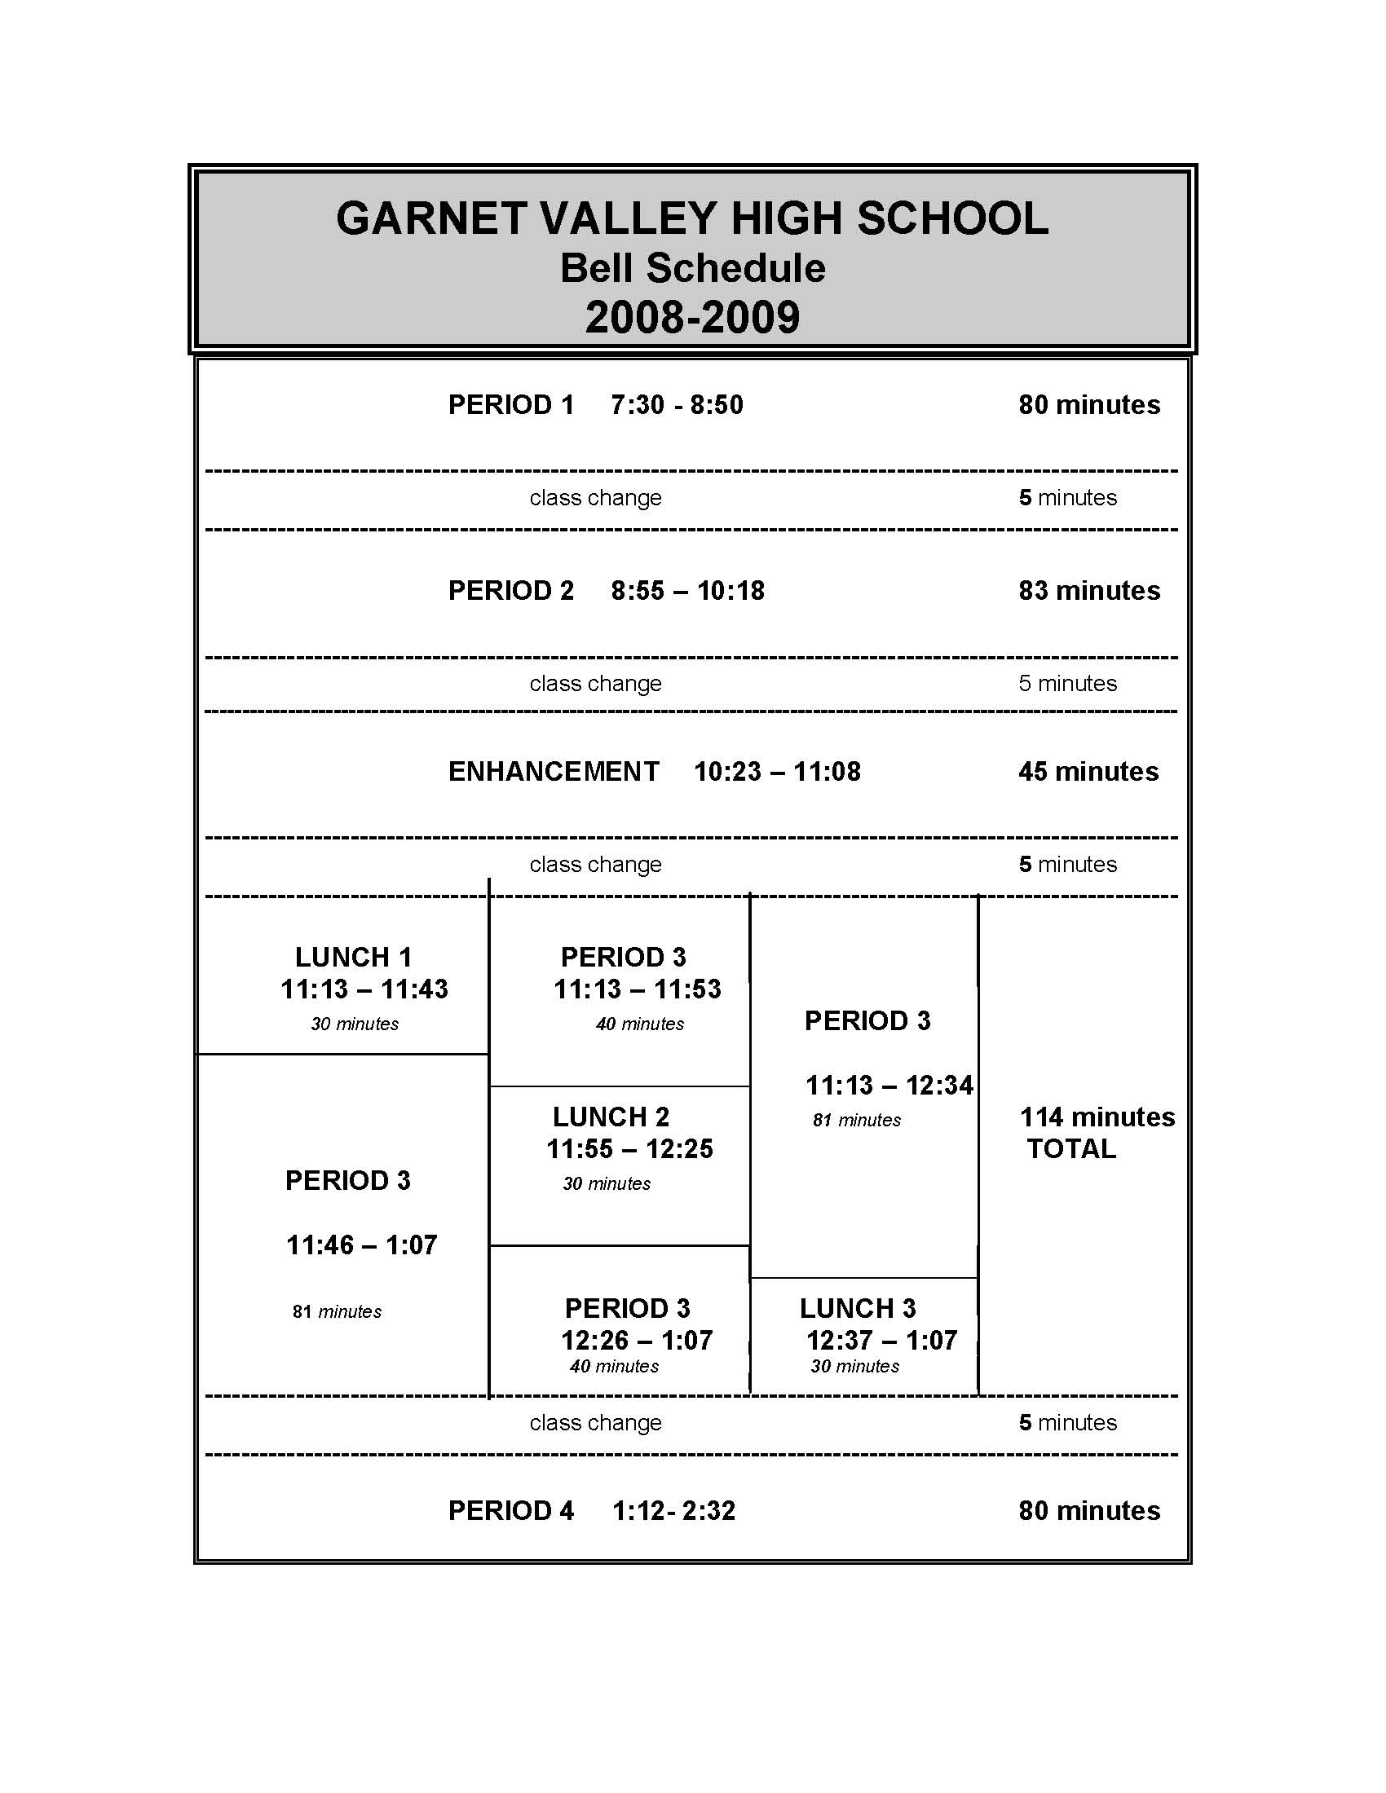
The Intervention/Enrichment Period

Slide 39
Sample “Enhancement Period” Schedule
Teacher | A Day | B Day | C Day | D Day | E Day | F Day
Math TA | Dept. | ALG. 1 Int. | Advisory | ALG. 1 Int. | Math Club | Alg. 1 Int.
Math TB | Dept. | AP Calc. Help | Advisory | ALG. 2 Int. | AP Calc. Help | ALG. 2 Int.
SS TA | Forensics | Dept. | Advisory | WH Int. | WH Int. | WH Int.
SS TB | US H Int. | Dept. | Advisory | US H Int. | US H Int. | Stu. Gov’t
SC TA | AP Bio. Help | Bio. Int. | Advisory | Dept. | Bio. Int. | Bio. Int.
SC TB | AP Chem. Help | Chem. Int. | Advisory | Dept. | Chem. Int. | Chem. Int.
Eng. TA | Eng. 9 Int. | Eng. 10 Int. | Advisory | Eng. 9 Int. | Dept. | Eng. 10 Int.
Eng. TB | Eng. 11 Int. | Eng. 12 Int. | Advisory | Eng. 11 Int. | Dept. | AP Eng. Help
Band | Band | Jazz Band | Advisory | Band | Jazz Band | Dept.
Choir | Girls CH | Choral | Advisory | Girls CH | Choral | Dept.
SPED | Learning Support | Learning Support | Advisory | Learning Support | Learning Support | Dept.
Attendance | Make-up | Make-up | Advisory | Make-up | Make-up | Make-up
CTE TA | LAB | LAB | Advisory | U Tube | LAB | Dept.

Slide 40
Scheduling the High School Intervention/Enrichment Period
Notes:
Designing Quality Elementary School Master Schedules
12/2/09
Michael D. Rettig, rettigmd@jmu.edu
40

Slide 41
Key Factors: I/E
Scheduling the Intervention/Enrichment period is easy compared to organizing and preparing for instruction within it.
All students and staff must be productively engaged during the period.
Clear, consistent, and involved leadership is required to ensure that assessment, data analysis, tiering, planning intervention and enrichment instruction, and progress monitoring all are carried through.
Time must be allocated for planning for groupings and instructional activities.
It may be wise to select specific programs for enrichment and/or intervention activities rather than having teachers design their own.
It may be wise to start out providing interventions in one subject only, most likely language arts.
A standard assessment tool should be used to determine groupings (Dibles, PALS, district quarterly assessments, etc.).
An Response to Intervention (RTI) type tier structure based upon this assessment is necessary to allocate students to enrichment, moderate intervention and intensive intervention groups.
A decision must be made as to whether or not special services (i.e. special education or ESOL) will be “the” intervention for some qualifying students during the I/E time or will they be served at a different time by those professionals.

Slide 42

www.schoolschedulingassociates.com
Notes:
Designing Quality Elementary School Master Schedules
12/2/09
Michael D. Rettig, rettigmd@jmu.edu
42

Slide 43
References
Ball, W. H. and Brewer, P. F. (2000). Socratic seminars in the block. Larchmont, NY. Eye On Education.
Blaz, D. (1998). Teaching foreign languages in the block. Larchmont, NY: Eye on Education.
Canady, R. L. & Rettig, M. D. (Eds.) (1996). Teaching in the block: Strategies for engaging active learners. Larchmont, NY: Eye On Education.
Canady, R. L. & Rettig, M. D. (1995). Block scheduling: A catalyst for change in high school. Larchmont, NY: Eye on Education.
Conti-D’Antonio, M., Bertrando, R. and Eisenberger, J. (1998). Supporting students with learning needs in the block. Larchmont, NY: Eye on Education.
Gilkey, S. N. and Hunt, C. H. (1998). Teaching mathematics in the block. Larchmont, NY: Eye on Education.
Pettus, A. and Blosser, M. (2001). Teaching science in the block. Larchmont, NY. Eye On Education.
Canady, R. L. & Rettig, M. D. (2008). Elementary school scheduling: Enhancing instruction to increase student achievement. Larchmont, NY: Eye on Education.
Rettig, M. D., McCullough, L. L., Santos, K. E., Watson, C. R. (2004). From Rigorous Standards to Student Achievement: A Practical Process. Larchmont, NY: Eye On Education.
Rettig, M. D. & Canady, R. L. (2000). Scheduling strategies for middle schools. Larchmont, NY: Eye On Education.
Rettig, M. D. & Canady, R. L. (1998). High failure rates in required mathematics courses: Can a modified block schedule be part of the cure? NASSP Bulletin,82(596), 56-65.
Rettig, M. D., McCullough, L. L., Santos, K.E., and Watson, C.R. (2004). From rigorous standards to student achievement: A practical process. Larchmont, NY: Eye on Education.
Strzepek, J. E., Newton, J., and Walker, L. D. (2000). Teaching English in the block. Larchmont, NY: Eye On Education.

